Slide 1

Extending Patient Choice of Any Qualified Provider
Provider Perspective
Krys Jarvis, Chairperson

Slide 2
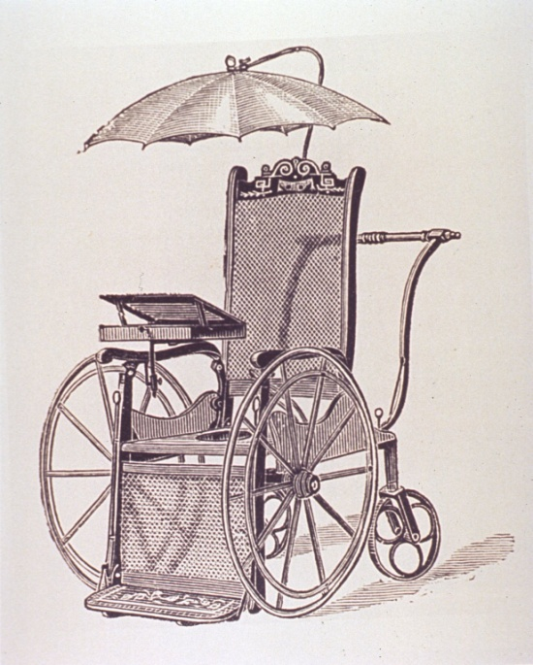
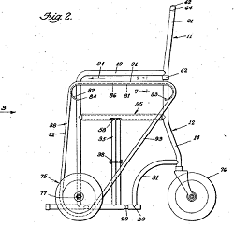

Past

Slide 3
How did we get here?
1953 – 1984 Managed by DHSS
1986 McColl report published
1987 DSA (Disablement Services Authority)
1991 transfer to local health authorities
Locally based services

Slide 4
History of the Forum
In April 1991 responsibility for wheelchair provision was devolved to local health authority level. During 1991 the development of the Forum began. A meeting of wheelchair service managers was arranged and the first Forum met in November 1991 in London. The first formal meeting of the Forum was in February 1992. A draft constitution was written and later ratified. The first committee was established.

Slide 5
Work of the Forum
The Forum provides the focus for discussion and exchange of ideas on topics relevant both at local and
national level.
The Forum has always been concerned with setting of wheelchair service standards, their development and improvement to maximise the outcome for service users. In 1993 a working party produced a booklet “National Guidelines for Wheelchair Services”.
Work has continued on developing standards and in 2004 the Forum together with other interested parties produced a document “Minimum Standards for Wheelchair Services”.

Slide 6
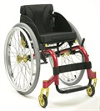
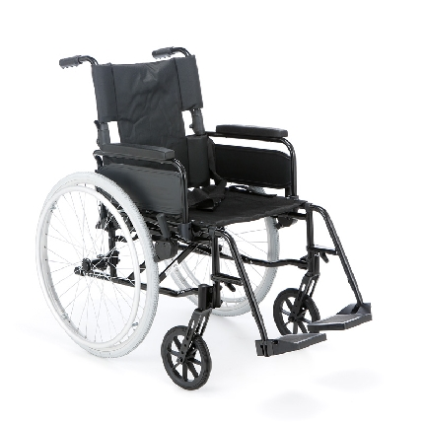
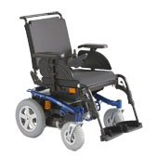
Present
Future?

Slide 7
Wheelchairs
The Service in Context
Approx £40M state annual spend on Wheelchairs with a further £40M on overheads
Approx 1.2 million wheelchair users in England – just over 2% of the population – DRC report suggests a higher number
825,000 regular users – unknown number of time limited users
2004/5 1 million disabled children population increased by 2% year on year since 1975
Older people population increasing by 3% per year over next 10 years
Around 150 Wheelchair Service and Seating Centres in England
(Figures collated in 2007)

Slide 8
Previous Wheelchair Service Reports
1986 The McColl Report
1987 - 1991 Disablement Services Authority
1991 Services devolved to local districts (151)
1993 - 1996 National Prosthetic and Wheelchair Services Report (Holderness Report)
1996 EPIOCs and Vouchers introduced – ring fenced budget to 2000
2000 Evaluation of the Powered Wheelchair and Voucher System (York Report)
2000 Fully Equipped – Audit Commission report
2002 Full Equipped – reported little to no progress on original report
2002 Wheelchair Service Collaborative – 44 Services included
2003 Guidance on Commissioning of Wheelchair Services – Audit Commission
2004 NHS Wheelchair and Seating Services Mapping Project - Empower
2004 Standards for Wheelchair Services under the NHS – NWMF etc.
2004 Procurement Guide – Contracted Wheelchair Support Services- PASA
2004 Clinical Guidelines on Specialised Seating – BRSM
2005 Good practise guide from Wheelchair Service Collaborative
2006 Care Services Improvement Partnership Out and About
2007 Transforming Community Equipment & Wheelchair Services Programme
2010 Local innovations in wheelchair and seating services

Slide 9
So….AQP….What did we think?
Collectively not a lot!
Knee jerk reaction to spiralling demands and costs
Introduced on the back of lobbying for children
NHS services felt let down and criticised
Resigned to AQP
Embrace AQP

Slide 10
AQP – The Future!
Positives
Consultation
Service Specifications
Commissioner involvement
High on Agenda
Pricing Matrix
Quality/Outcome Measures
Data collection

Slide 11
And There’s More……….
Clarification regarding eligibility
Further specifications
Ongoing dialogue
Ownership no longer with the service
Opportunities to improve service delivery and response to patients
Support from provider organisations to retain/attract business

Slide 12
Challenges for current providers
New service provision – letting go!
Business model
Continuing Collaboration
Sharing Best Practice
Marketing!!

Slide 13
Patient Choice

Slide 14
Fear Not! (Strengths)
Beginning with Non-Complex
Knowledge of the market/demand
Clinical Expertise/Quality agenda
Service Delivery
Knowledge of support services with established contacts
Dialogue with suppliers
Opportunities to increase service delivery

Slide 15
Opportunities
Breakdown of geographical boundaries
Could AQP reduce the load of local NHS services allowing skills to benefit complex users?
Could there be a place for partnerships?
Will it drive down prices from manufacturers?
Could it provide a more responsive service?

Slide 16

Timely & Appropriate
Provision of Service

Slide 17
More Questions:-
‘Duty of Care’
Re-cycling
NHS Requisition/ordering policy
Concerns that commissioners will not listen to advice
Split service – accountability and management of disputes ?
IT infrastructure and confidentiality
Who will maintain equipment on issue and provide on-going clinical support to existing users?
Clear pathway for re-referrals

Slide 18
Wheelchair user group concerns
Will experienced NHS staff move to other providers?
Will all providers have the same duty of care as the NHS?
Will all providers be as ethical as the NHS?
Will all providers have the same level of scrutiny?
NHS is impartial and will use any equipment to meet a clinical need. This may not happen with other providers
Will my records still be confidential – how will they be shared with other providers?
NHS has clinical expertise, that may not be found in other providers

Slide 19
Concerns about split model
Ability to write a prescription that enables user to have choice of equipment
Most non standard chairs require assessor to commission the chair at delivery
High number of non standard chairs require fitting of range of accessories
Large number of bespoke modifications required, normally the domain of the assessor to manufacture & fit

Slide 20
Advantages of integrated approach
Overall accountability
Assessor responsible for outcome
Integrated handover, supply and fit
Easy access to on-going support
One stop shop for users
Continues to offer choice to users
Needs an agreed pathway to ensure level competition

Slide 21
    ?
    Is the devil you know
    better than
    the devil you don’t

Slide 22
Simple versus Complex
Specialist wheelchair clinicians take into consideration a spectrum of needs including social, educational, employment and charities; linking with the appropriate professionals for support and guidance to reduce the stress for the client and hence provide a seamless service wherever possible
Assessment is holistic, funding is not…. yet

Slide 23
Simple or Complex? (1)
Referral for a child with limited mobility, ventilator dependent, required for “outdoor use & less than 3 times a week” (but more in the holidays)
Following the current spec. – not eligible as usage less than 4 times a week
Triaged by a specialist clinician identified assessment due to ventilator dependency
Assessment established child required a ventilator, suction machine, oxygen cylinder and an emergency bag of medical items. Child also had a scoliosis, currently not operable and tilt required if his tracheotomy tube became detached
Stability now an issue due to equipment required
Risk assessment needed to support the suitable positioning and securing of the oxygen cylinder and medical devices
Solution Tandem buggy with lateral postural support, provided without the second child's seat fitted to allow space for his medical equipment

Slide 24
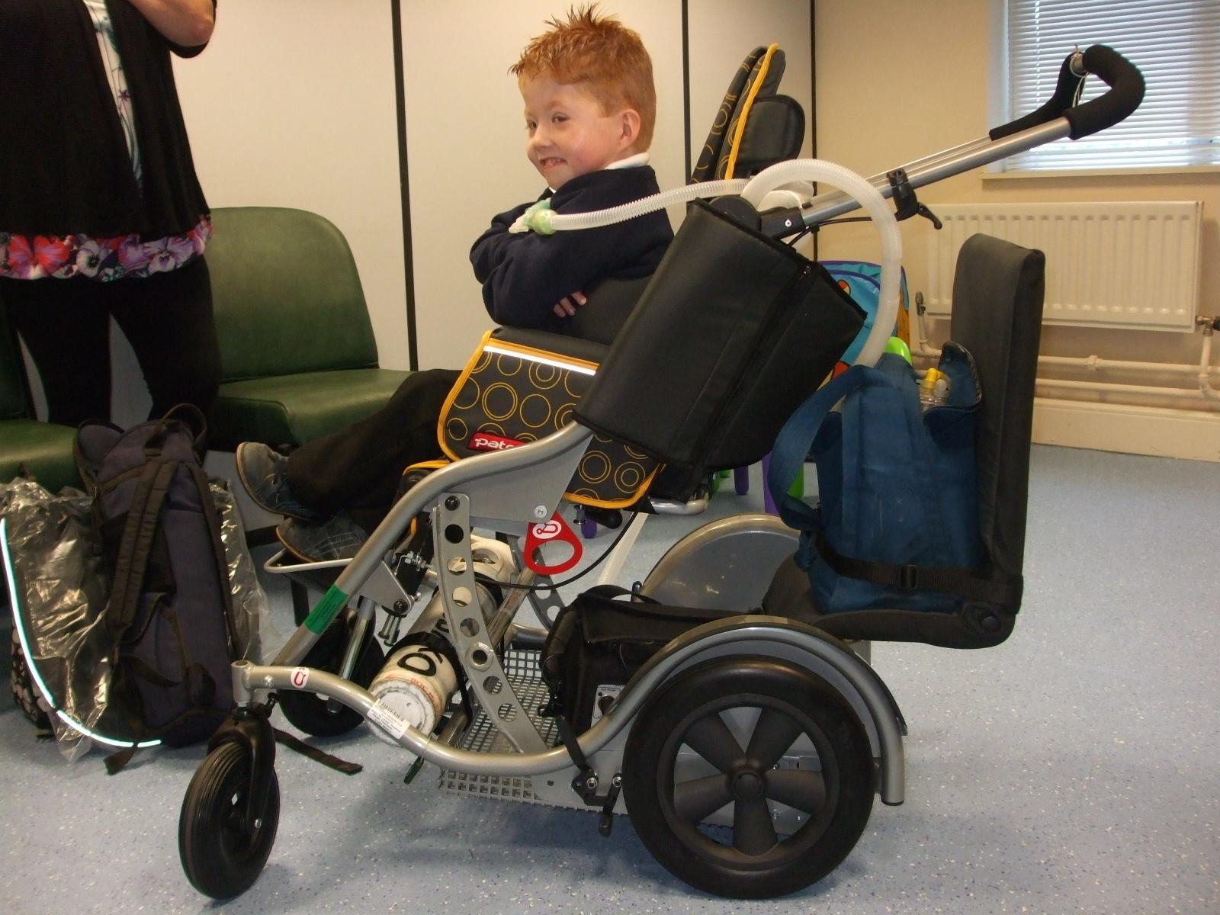

Slide 25
Simple or Complex? (2)
Motor Neurone Disease (MND) Appears simple as outdoor mobility often the initial requirement
Fast deteriorating situation becoming complex with functional deterioration, requiring complex postural & mobility services
Early provision allows the development of wheelchair skills and aid psychological acceptance of future equipment as required
Specialist wheelchairs and accessories often held separately for immediate provision
Urgent appointments required with provision of a variety of specialist extras i.e. elevating leg rests, postural support and tilt mechanism, specialist headrests
Removal of the wheelchair in a timely and professional manner is very important

Slide 26
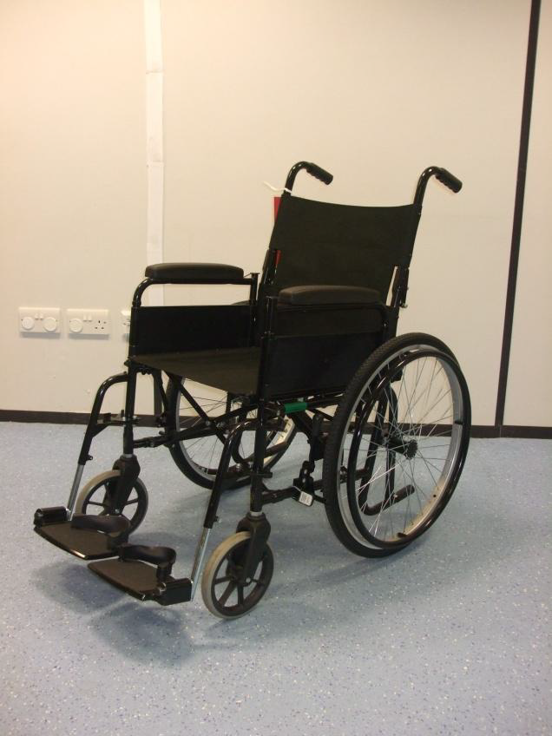
With MND the Wheelchair Needs Can Change Rapidly
From this simple wheelchair
To dual powered controls
To a postural reclining & tilting wheelchair

Slide 27
Questions to consider when choosing a provider
Do they have the clinical experience and medical expertise to identify if a medical condition is simple or complex?
Some complex cases can be solved by an ‘off the shelf’ modular piece of equipment, however it’s the knowledge about the existence of these pieces of equipment that is often specialist.
Does the provider have suitable facilities for clients and offer home assessments?
Would the provider be able to transfer clinical information safely and confidentially between other services when a simple case becomes complex?
Is the provider able to use commissioner criteria consistently through the process of assessment to provision?
Is the provider able to maintain the wheelchairs on issue to Manufactures specifications and respond to MHRA alerts?.

Slide 28
So...What do we think now?
Subscribe to the need for change
Enthusiastic about opportunities to improve services for users
Keen to share our knowledge with commissioners to support lasting improvement
But anxious not to lose strengths
Also share concerns and caveats – reliance on current inaccurate data capture to set tariffs
Above all we are keen to work with you

Slide 29
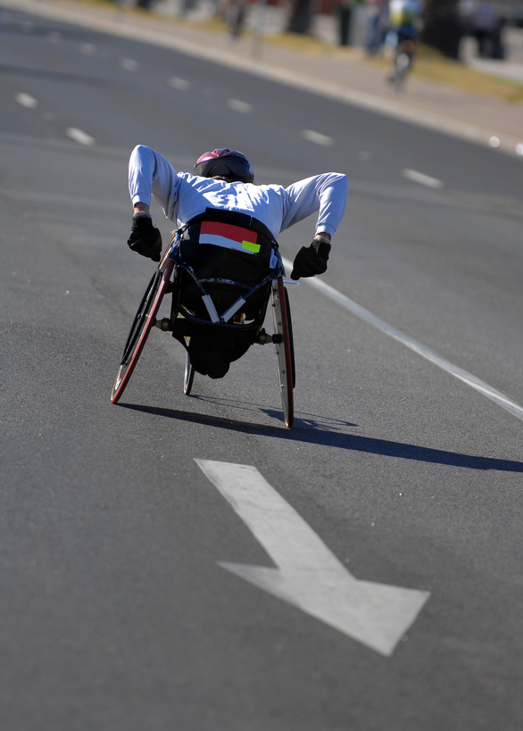
Sometimes
Change
Is
An
Opportunity

Slide 30

And
Best
To get
Right
First
Time!

Slide 31
Thank you for listening!
Thanks to Henry Lumley for some of the content!

