Slide 1
National Wheelchair Services Provider Engagement Event
3rd April 2012
NHS IT Requirements To Support AQP
Mark Dye – CFH

Slide 2
NHS IT Infrastructure
The NHS and organisations supporting the NHS use varying software applications/products to provide NHS services.
To support AQP there is a need to connect to the following Connecting for Health services:
    Information Governance Toolkit
    Organisation Data Service
    N3
    NHS Mail
    Choose and Book
    Smartcard

Slide 3
What do these do ??
Information Governance Toolkit - Information Governance ensures that the way organisations ‘process’ or handle electronic information is completed in a secure manner. This is to ensure that NHS data security is not compromised.
Information Governance provides a way for organisations/employees to deal consistently with the many different rules about how information is handled.
Organisation Data Service- Provides a coding structure which identifies Organisation name and address details, this is also used to define messaging, financial transactions, reporting etc.

Slide 4
N3- N3 access(NHS national network) this allows secured transmission of data, via a secured broadband service and server to support this.
NHS Mail- Allows a secured email account to be set up against an organisation.
Choose and Book- is a national electronic referral service which gives patients a choice of place, date and time for their outpatient appointment in a hospital or clinic. A directory of services is ‘store front’ to allow equal billing with larger providers.
Smartcard- Allowing you access to use NHS systems and services.

Slide 5
AQP Checklist
There is an understanding that some providers applying for AQP will already be connected to Spine system, a checklist will be provided for you to complete.
CFH will validate the checklist and inform the AQP policy team that all required IT requirements have been met.
For organisations that have not met these requirements there will be information on how to connect to these systems at: www.supply2health@nhs.uk

Slide 6
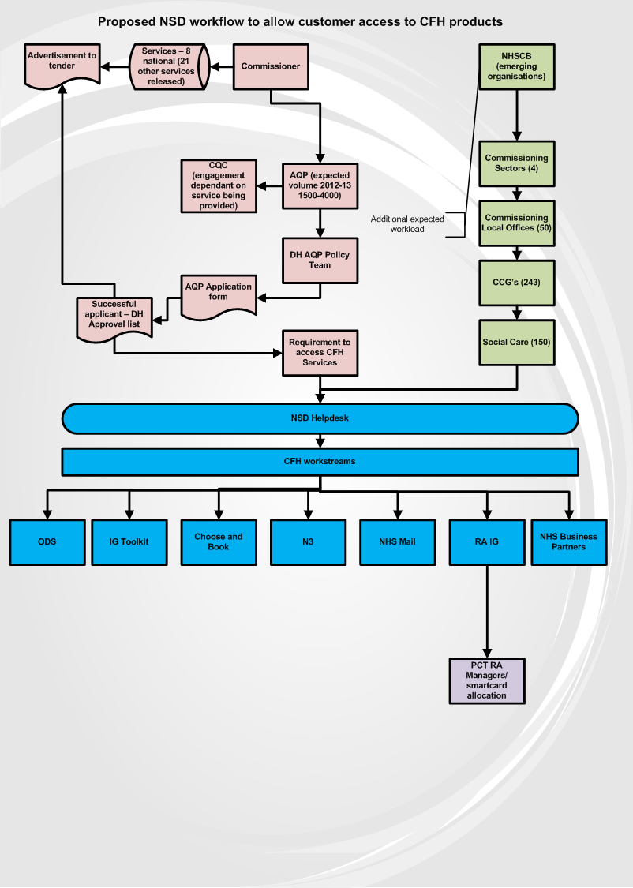
Any Qualified Provider (AQP)

Slide 7
Questions

