Slide 1
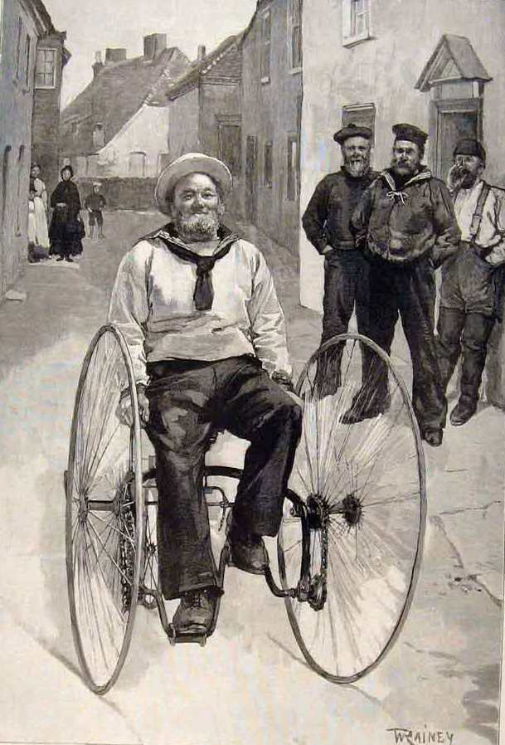
AQP
A
user
perspective

Slide 2

Timely & Appropriate
Provision of Service

Slide 3
What is needed from a wheelchair service
Able to access independent, expert assessment when needed
Criteria set on clinical need not financial resource
If rationing criteria upheld , then access to assessment should still be available for all & recommended chairs should be available at same prices as those charged to NHS.
End to postcode lottery.
Speedy assessment and clear guidance as to what is needed

Slide 4
Close working between therapist and engineers
Continuity of care/ easy access to advice
Regular review and ability to adapt/ change provision when needs change
Regular maintenance
Emergency call out
Replacement chair when problems arise
Easy transition from service supplying simple requirements to service supplying complex needs.
National service framework standards

Slide 5
    ?
    Is the devil you know
    better than
    the devil you don’t?

Slide 6
Wheelchair user group concerns
Will experienced NHS staff move to other providers?
Will all providers have the same duty of care as the NHS?
Will all providers be as ethical as the NHS?
Will all providers have the same level of scrutiny?
How will AQP be funded?
NHS is impartial and will use any equipment to meet a clinical need. This may not happen with other providers
Waiting lists may increase
Why change a service that is working well and continuing to improve?
Client may move from one provider to another depending on what is offered
Will my records still be confidential – how will they be shared with other providers?
NHS has clinical expertise, that may not be found in other providers

Slide 7
Will charities be able to apply? They may be able to top up funds.
Vulnerable clients may not be supported in choices
Will clients be ‘sold’ equipment rather than meeting a clinical need?
Providers may ‘cherry-pick’ the easy & ‘profitable’ clients, leaving the NHS with those who have complex needs
AQP is penalising good services – better to learn and make improvements
There is confidence and trust in the NHS – why change this?
NHS has clinical expertise, that may not be found in other providers
May lead to a change in client/therapist relationships as a business model may be assumed
If the only the purchasing contract goes to AQP, how will this fit with the repair service?
Will the Repair service be just as responsive as it currently is?

Slide 8
AQP v NHS
NHS alone
Skilled staff
Integrated service
But
Under-resourced
Rationing criteria/postcode lottery
Wasteful on occasions
Does it always get best prices for equipment?
Can be slow responding
AQP alone
Who will provide service?
Will it be piecemeal and not integrated?
Will it be profit based and not needs based?
Who will guide patient choice?
But :
Could provide for disease specific need
Could do complex cases
Might be better resourced

Slide 9
NHS + AQP
Could there be a place for partnerships?
Could specialist AQP take some of the load off the local NHS services?
Will it drive down prices from manufacturers?
Could it provide a more responsive service?
Enable better eligibility criteria

Slide 10
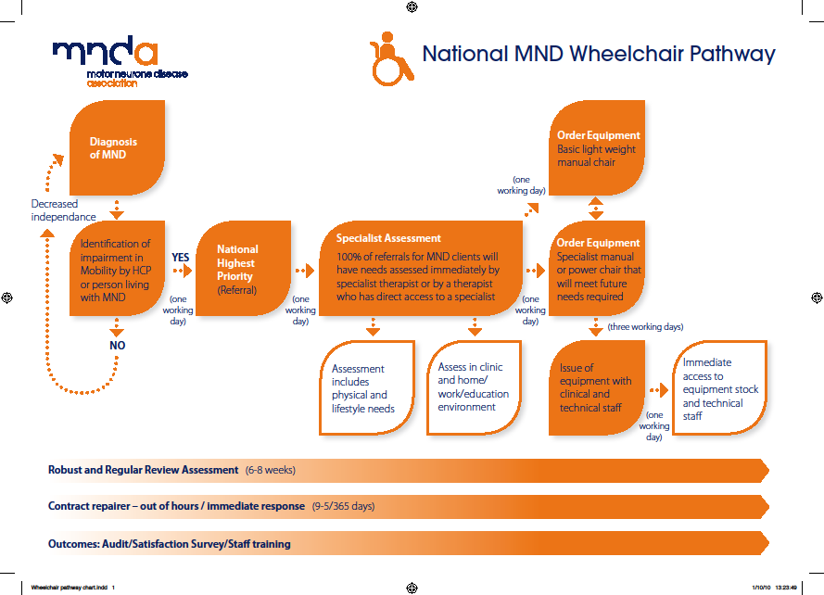

Slide 11

Sometimes
Change
Is
An
Opportunity

Slide 12

And
Best
To get
Right
First
Time!

