Slide 1

Extending Patient Choice of Any Qualified Provider National Wheelchair Services Provider Engagement Event, 10.00 to 15.30, 3 April 2012, Birmingham City Football Club, B9 4RL
Alan Norton
Chief Executive Assist UK
Notes:
Introduce self
Good morning, could I introduce myself I am Alan Norton CEO for Assist UK. Assist UK is a membership organisation of 41 independence/disable living centres spread across the UK. We give free advice, assessment and a chance to try equipment to gain or retain independence.
I have been asked to speak today to give a users perspective of Any Qualified Provider.

Slide 2
Any qualified provider
Wheelchair services
South West and South East of England Pilots
Wheelchair Engagement Meetings
Notes:
At present we have wheelchair services that offer a postcode lottery of services with many people experiencing poor service and unacceptable waiting times. Choice of products is limited with a criteria based on cost not empowering the client. Last year I was fortunate enough to be involved with the South West and South East of England pilots which aimed at shaping the minimum standards for wheelchair services. More recently I have been involved in wheelchair engagement meetings, where users and third sector organisations have had direct involvement in shaping Any Qualified Provider.

Slide 3


AQP Benefits
Person Centred Approach
“Users repeatedly intimated that they want increased choice and control over the management of their conditions and particularly choice of equipment. Users want to be treated like consumers”.
Notes:
There are many benefits from ensuring AQP delivers appropriate services and I believe the process has given ample opportunity for all involved in the provision of wheelchairs a chance to comment. I have taken this quote from deep within the text of the guidance documents which shows new thinking in that it concentrates on the need of the user.

Slide 4
PATIENT PROSPECTIVE
Choice
Involvement
Lifestyle
Getting the right gearing will
lead to successful services
Notes:
We have a great opportunity of reshaping wheelchair services and by including the right elements we will give independence to many who are leading restricted lives.

Slide 5
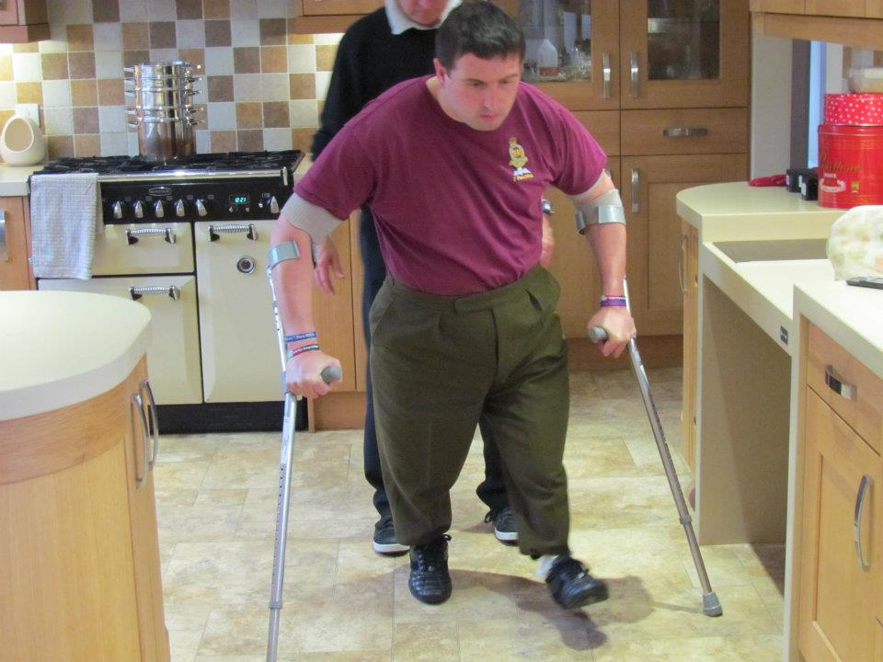

SUPPORT
Enable the person rather than change the environment it will probably be cost effective
What’s Key – INFORMATION
- ASSESSMENT
- RANGE
- CHOICE
- FLEXIBILITY
Notes:
It is essential that we provide the right support at the right time to do this we need to think about empowering users with the right information, an holistic assessment, a range of products, choice to match lifestyle and flexibility in integrating services.

Slide 6
Customer wish list
client
Meets life style
Information
Freedom of choice
Experts
Back up
service
Maintenance
Notes:
To provide a worry free service clients need some basic essential ingredients:-
The equipment needs to meet
Lifestyle
Comprehensive maintenance
Rapid back up services in the event of breakdowns
Information on new products and the freedom of choice
Freedom to choose
Any Qualified Provider will give the freedom for local services to have a template for success.

Slide 7
Thank you

