Slide 1
Risk and decision-making
Trudy Reynolds
Anita Kromer

Slide 2
Nature of risk
Clinical risks: related to the health and wellbeing of the person or their carers and satisfactorily meeting outcomes.
Financial risks: value for money, appropriate use of resources, individuals’ ability to manage accounts.
Reputational risks: potential to affect the reputation of the CCG e.g. through adverse media coverage.

Slide 3
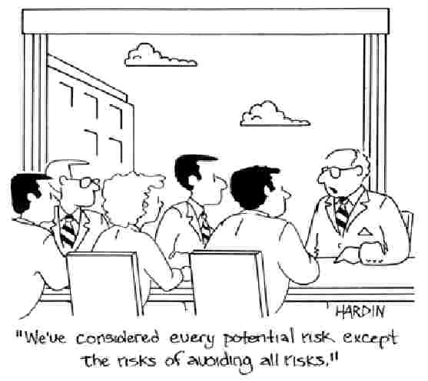

Slide 4
Duty of care
Duty of care can be said to have reasonably been met where an objective group of professional considers:
All reasonable steps have been taken.
Reliable assessment methods have been used.
Information has been collated and thoroughly evaluated.
Decisions are recorded, communicated and thoroughly evaluated.
Policies and procedures have been followed.
Practitioners and their managers adopt an investigative approach and are proactive.

Slide 5
Eliminating risk?
“It is not possible, nor arguably desirable, to eliminate risk. Empowerment in safeguarding involves risk management that is based on understanding the person, understanding the autonomy of the person and how they view the risks they face. There may be risks the person welcomes because it enhances their quality of life; risks the person is prepared to tolerate and risks they want to eliminate.”
Safeguarding Adults: The role of health service practitioners. Department of Health, March 2011

Slide 6
Sensible risk appraisal
“The emphasis must be on sensible risk appraisal, not striving to avoid all risk, whatever the price, but instead seeking a proper balance and being willing to tolerate manageable or acceptable risks as the price appropriately to be paid in order to achieve some other good – in particular to achieve the vital good of the elderly or vulnerable person’s happiness. What good is it making someone safer if it merely makes them miserable?”
Lord Justice Munby. (2010)
‘What price dignity?’, keynote address at LAG Community Care conference: Protecting liberties, London, 14 July

Slide 7
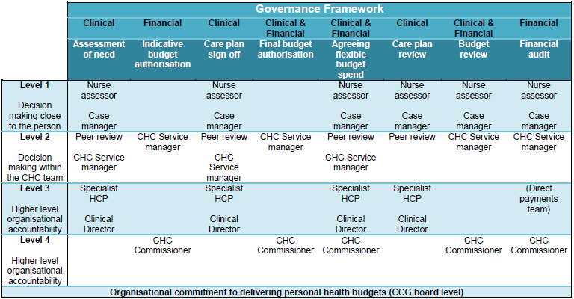
Governance framework

Slide 8
What do you need?
Clear roles and responsibilities.
A clear management structure for accountability.
A commitment to good quality supervision which includes professional development.
Agreed policies and procedures for delivering the service which everyone uses, including responses in crisis.
Agreed documentation for the needs assessment process, care planning, risk assessment, monitoring and review.
Timely process for resolving complex issues – panel with senior decision maker.
Processes for managing complex cases.
Processes for conflict resolution.

Slide 9
Risk enablement
Panels should be used only where needed, to support people with more difficult decision-making.
Risk should be considered throughout the care planning process, and as much agreement as possible sought at an early stage.
Processes should be transparent and decisions communicated clearly to all concerned.

Slide 12
Principles underpinning personal health budgets
NHS values still hold.
No entitlement to ‘more’.
Services should be safe and effective.
Personal health budgets should be a positive experience.
Access to services that best suit the individual.
Control over decision- making.
Not mandatory.
Support planning is key.

